Slide 1
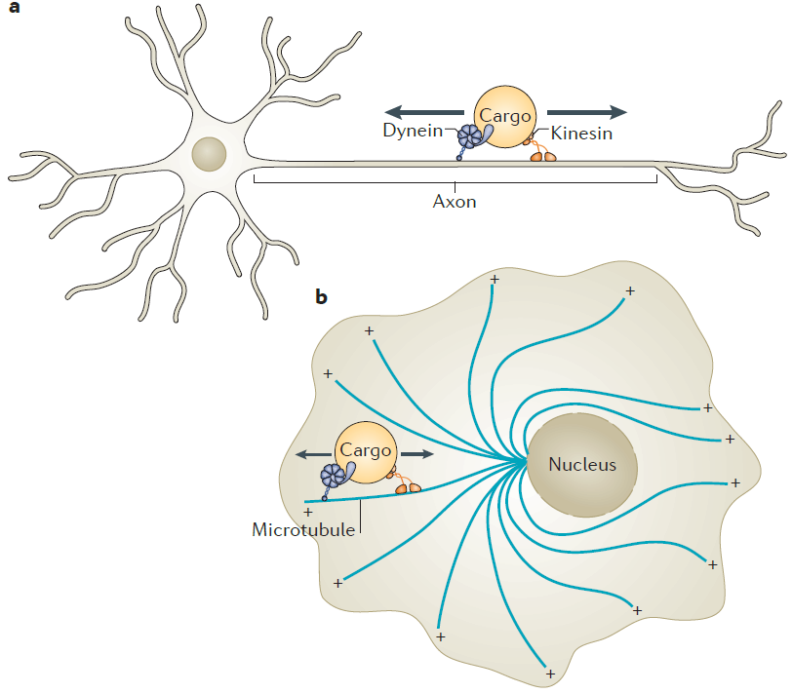
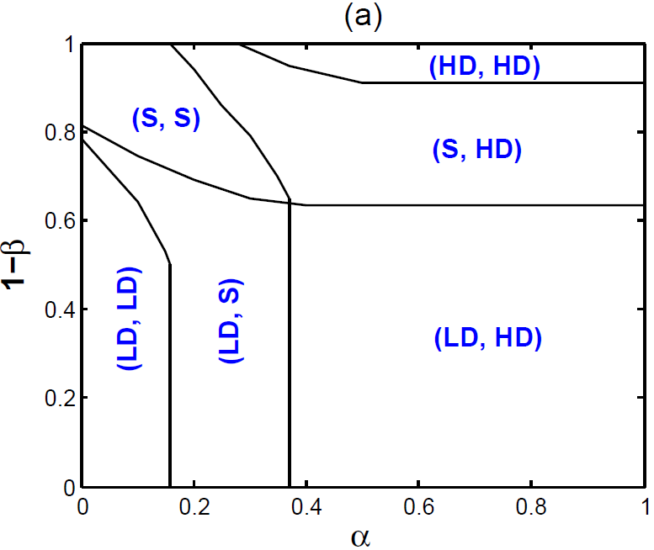
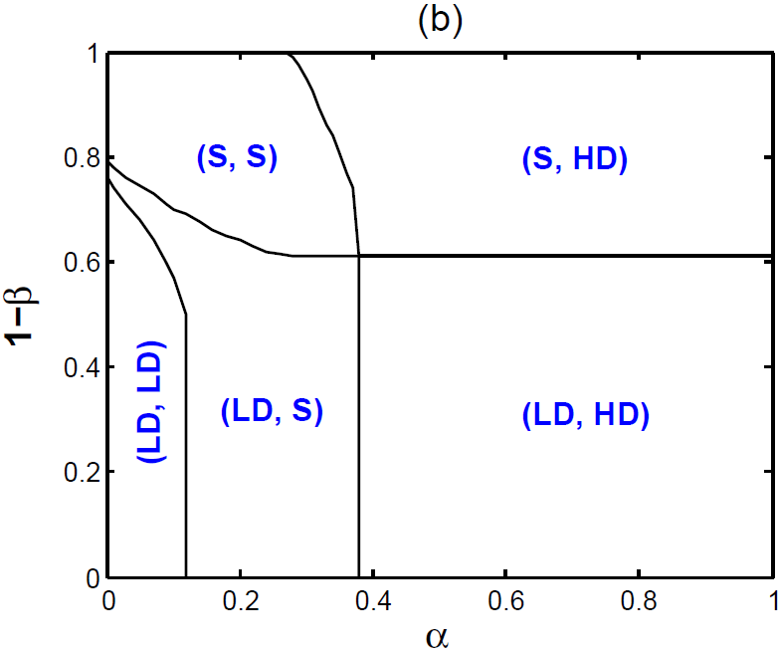
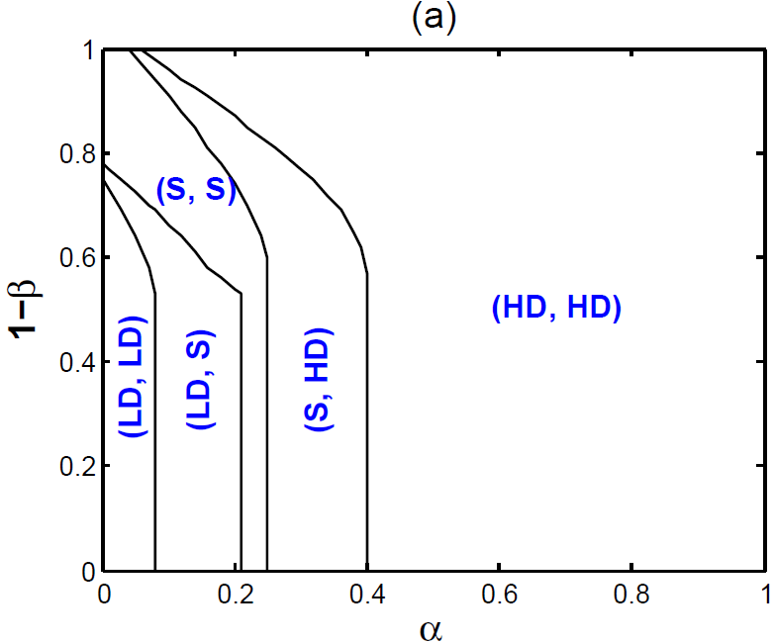
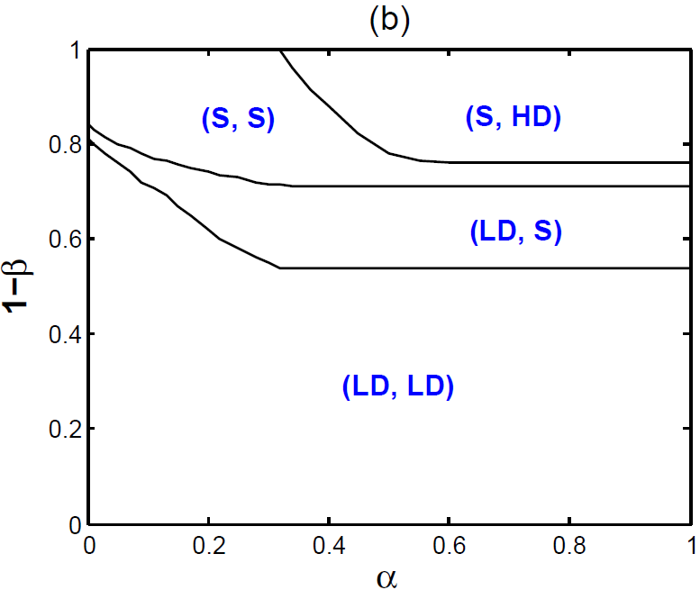
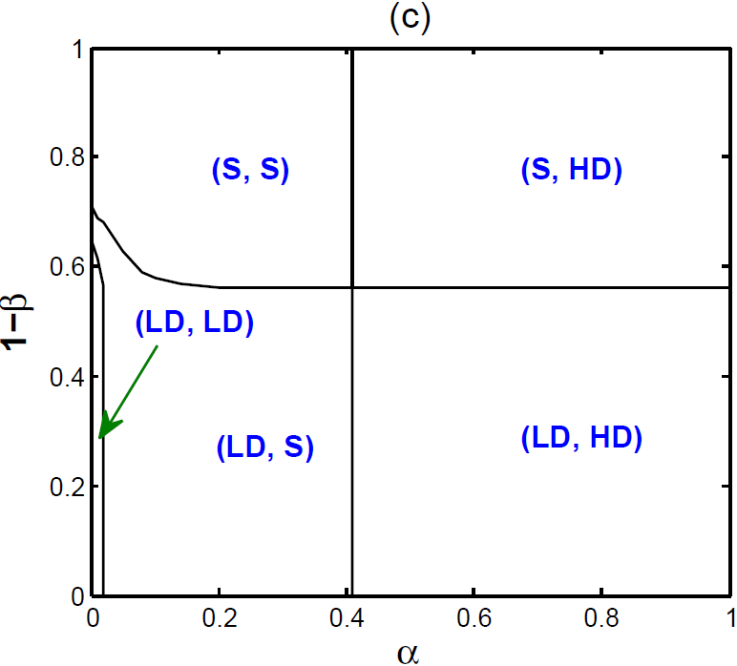
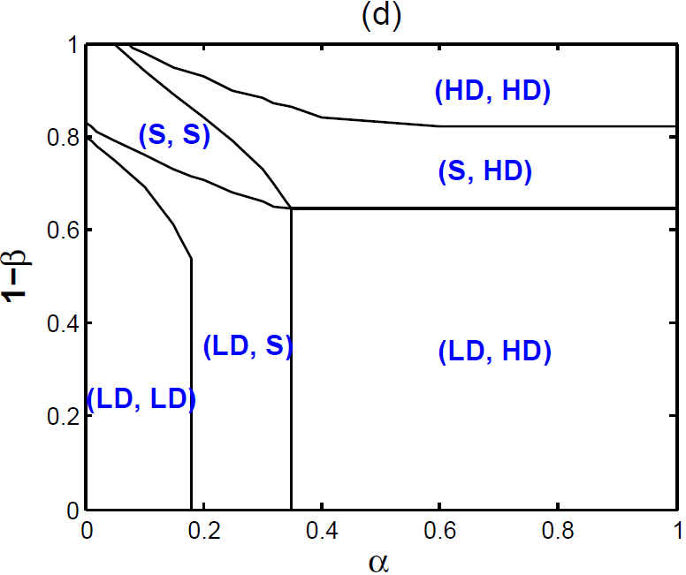
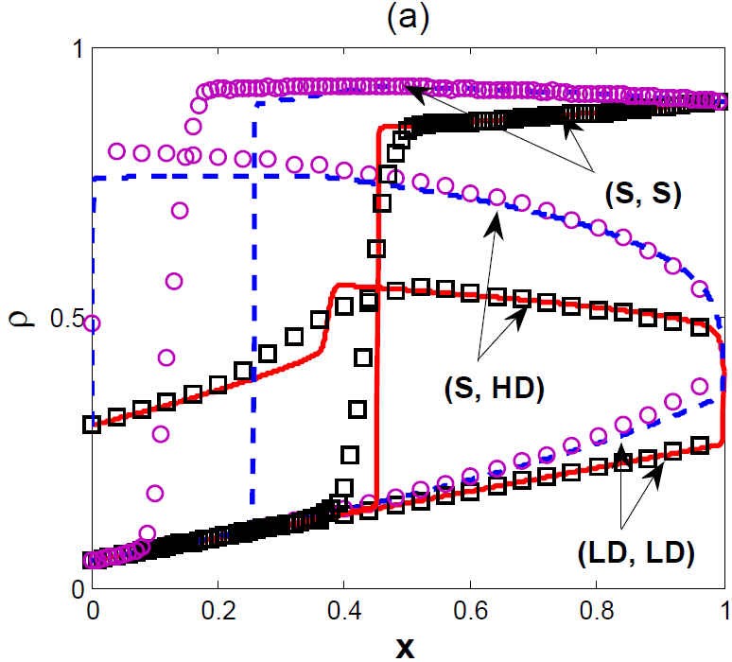
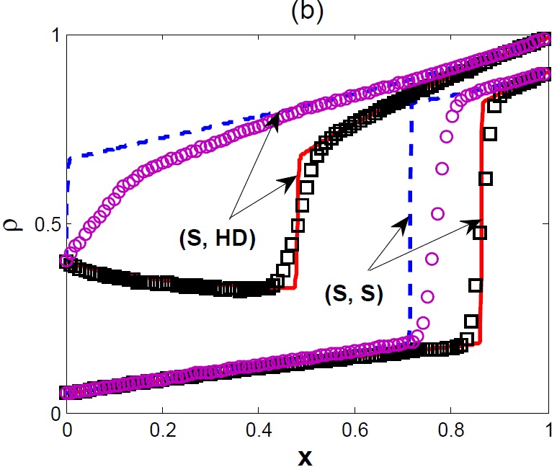
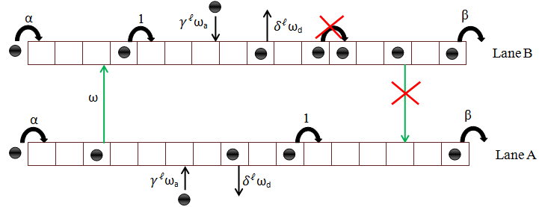
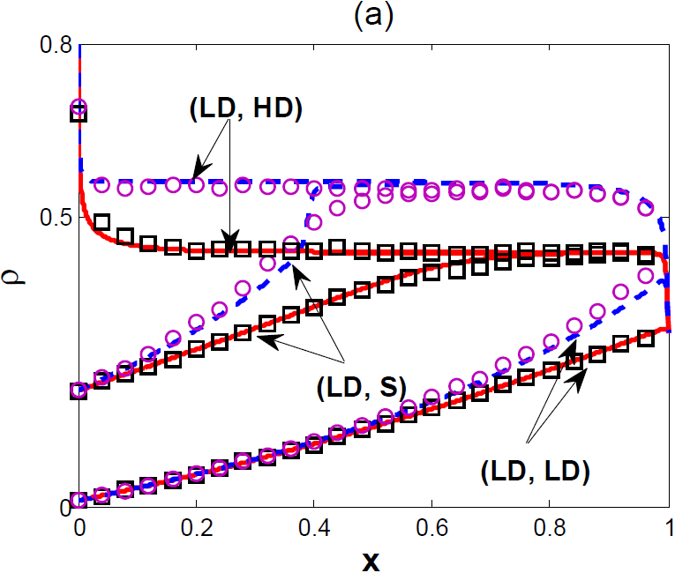
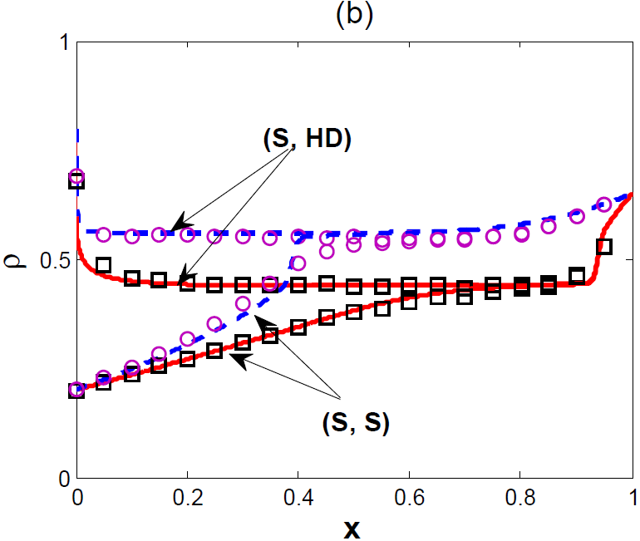
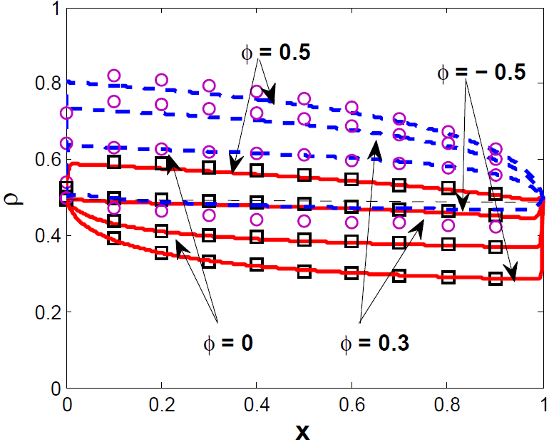
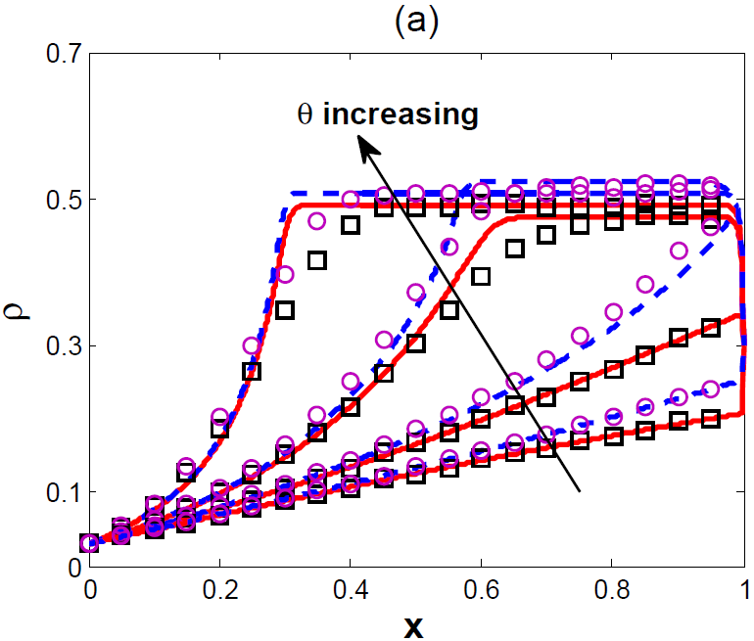
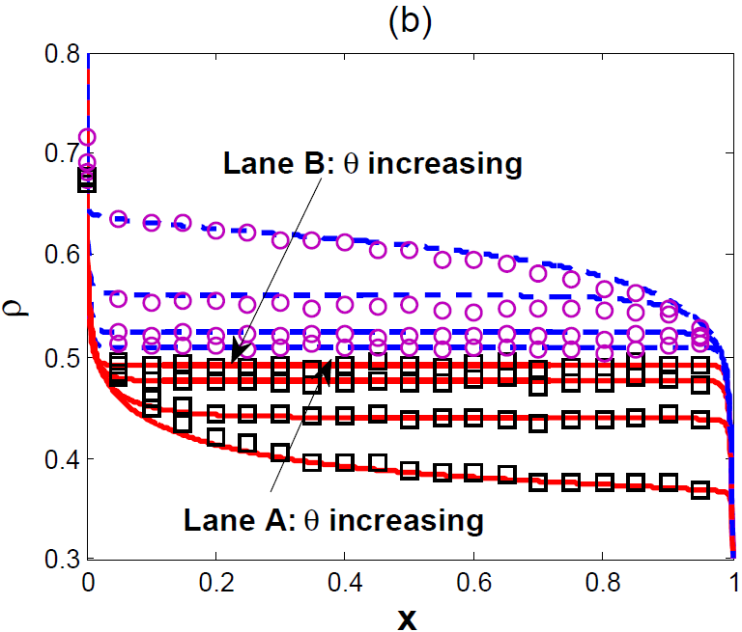
Effect of Mutually Interactive Langmuir Kinetics on the Collective Dynamics in a Two-Lane Asymmetrically Coupled TASEP Arvind K. Gupta Department of Mathematics, Indian Institute of Technology Ropar, India-140001 Email: akgupta@iitrpr.ac.in
Motivated by the recent in-vitro experimental observations on clustering of motor proteins on microtubules filament, the present work concentrates on analyzing the role played by the mutual interaction (MI) in two-channel biological transport processes.
Motivation
Continuum Mean-field Equation
Master Equation:
Boundary Conditions:
Parameters: ε = 1/L (lattice constant), Ω = ω L (lane-changing rate), Ω_{d} = ω_{d} L (detachment rate), Ω_{a} = ω_{a} L (attachment rate)
Results
Symmetric MILK
Antisymmetric MILK
We choose:
We choose:
Fig 1: (a) Neurons containing bound vesicles that are transported by molecular motor.
(b) Transport of cargo along microtubules inside a cell (ref. [1])
Goals
To explore the consequences of mutually interacted LK on the stationary density profiles
To derive steady-state phase diagrams and analyze the observed non-equilibrium phenomena
To investigate the role of symmetry of interaction via LK rates and its effect on the system dynamic
Fig 7: Phase diagram with Ω =1 and Ω_{d} = Ω_{a} =0.2 (a) Ø= 0.5, (b) Ø = - 0.5. Here, LD, HD and S denotes low density, high density and shock phase, respectively
TASEP 2×L model
Key points:
Fig 4: Phase diagram for Ω =1, Ω_{d} = Ω_{a} =0.2 (a) θ = 0, (b) θ = 0.5, (c) θ = 2.0, (d) θ = -0.5. Here, LD, HD and S denotes low density, high density and shock phase, respectively
Particles obey hard-core exclusion principle
Asymmetric lane-changing rule
Fig 8: Density profiles (a) ) (LD, LD) at (0.05, 0.4); (S, HD) at (0.3, 0.4); and (S, S) at (0.05, 0.9) with Ø= 0.5, (b) (S, S) at (0.05, 0.9); and (S, HD) at (0.4, 0.99) with Ø= -0.5
Fig 5: Density profiles with θ = 2.0 (a) (LD, LD) at (0.03, 0.3); (LD, S) at (0.2 0.3); and (LD, HD) at (0.8, 0.3) (b) (S, S) at (0.2, 0.65); and (S, HD) at (0.8, 0.65). The solid (dashed) lines in red (blue) color are the continuum mean-field density profiles of lane A (B). The curves marked with squares (circles) are the result of Monte Carlo simulations for lane A (B)
Fig 2: Illustration of the model. Crossed arrows indicate the forbidden transitions Two-channel totally asymmetric simple exclusion process with Langmuir kinetics with a bottleneck in lane A
Fig 9: Phase transition from (LD, LD) to (HD, HD) at (0.5, 0.5)
Dynamical rules
Conclusions
The effect of mutual interactions on the steady-state properties of the system is investigated using mean-field equations in the continuum limit.
Under the symmetric MILK in which both attachment and detachment rates increase or decrease simultaneously, the topology of the phase diagram remains qualitatively similar to the one obtained in the case of without mutual interaction. The only changes in the structure of the phase diagram are the gradual shifting of the phase boundaries and the shrinkage/expansion of various phases.
For antisymmetric MILK, it is observed that the topology of the phase diagram changes significantly with an increase in attractive/repulsive mutual interaction.
The results of continuum mean-field equations agree reasonably well with Monte-Carlo simulations.
If i = 1, particle enters at first site with a rate α, if it is vacant; otherwise particle moves forward
If i = L, particle exit out of the selected lane with a rate β, if it is occupied
For 1< i < L, if the site is empty, a particle can attach with a rate . Otherwise, it firstly tries to detach with a rate . If not, then particle tries to hop forward with unit rate; If it fails to do so, it will try to shift to other lane with rate ω. Here, no lane changing is allowed from lane B to lane A.
Note that the parameter represents the strength of modifying factors of LK rates as:
Fig 6: Effect of θ on density profiles in both the lanes for θ = 0, 2, 5, 10 (a) (0.03, 0.3) (b) (0.8, 0.3)
References
W. O. Hancock, Nature Rev. Mol. Cell Bio., 15, 615 (2014)
A. Parmeggiani, T. Franosch, E. Frey, Phys. Rev. E, 70, 046101 (2004)
A. K. Gupta, J. Stat. Phys. 162, 1571 (2016)
W. H. Roos, O. Campàs, F. Montel, G. Woehlke, J. P. Spatz, P. Bassereau, G. Cappello, Phys. Biol. 5, 046004 (2008)
Acknowledgements
DST India support # SB/FTP/MS-001/2013
Organizers of STATPHYS 26 for partial financial support
IIT Ropar for financial support
Fig 3: Schematic diagram of mutually interactive Langmuir Kinetics (MILK)

